Slide 1

Participant Details
Participant name:
Problem Statement:

Slide 2
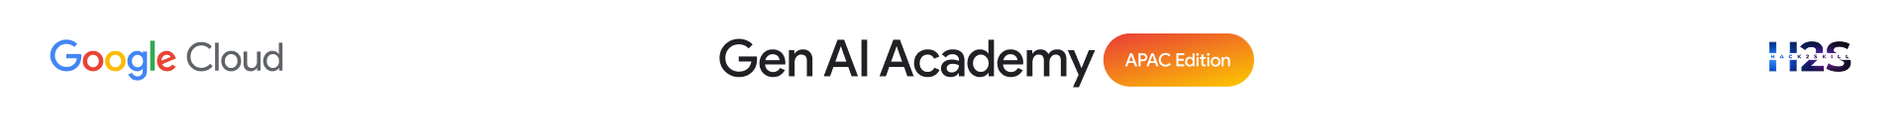
Brief about the idea
Type here…

Slide 3
Meeting the Build Criteria
How did you navigate the requirements of your chosen track to build a custom solution - using ADK, MCP, or AlloyDB AI that effectively addresses the 'What You Must Build' criteria?
Type here…

Slide 4
Opportunities
How different is it from any of the other existing ideas?
How will it be able to solve the problem?
USP of the proposed solution
Type here…

Slide 5
List of features offered by the solution
Type here…

Slide 6
Process flow diagram or Use-case diagram
Type here…

Slide 7
Technologies to be used in the solution
Type here…

Slide 8
Snapshots of the prototype
Type here…

Slide 9


